Slide 1
Muxes, Decoder, ROM
Matthew, Kendall, Martin

Slide 2
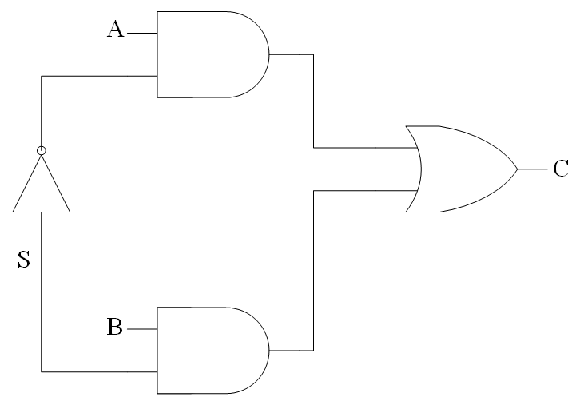
MUX
0
0
1
0
0
0
0
0
0
0

Slide 3
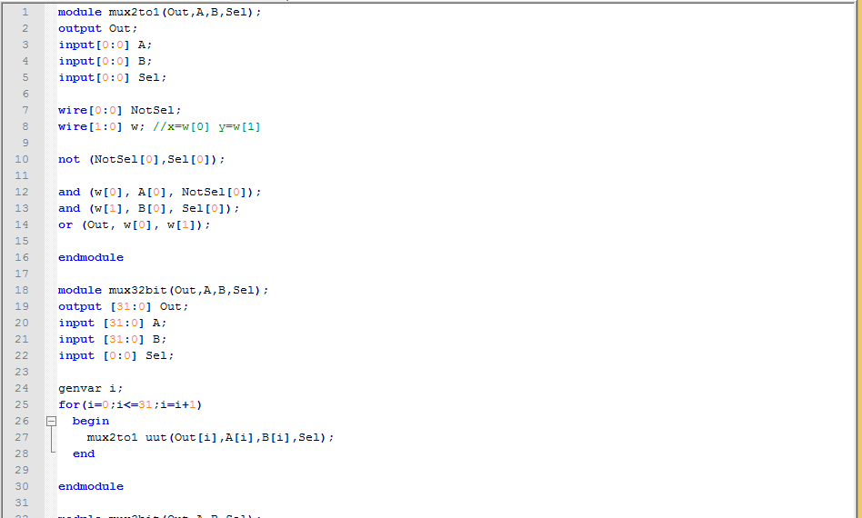
MUX.v

Slide 4
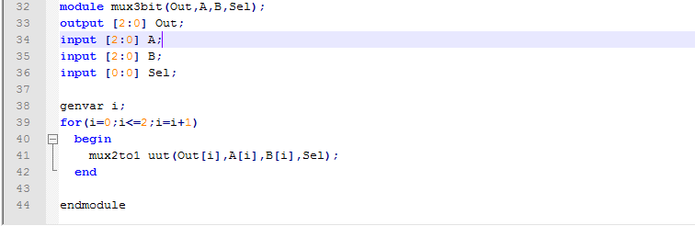
MUX.v

Slide 5
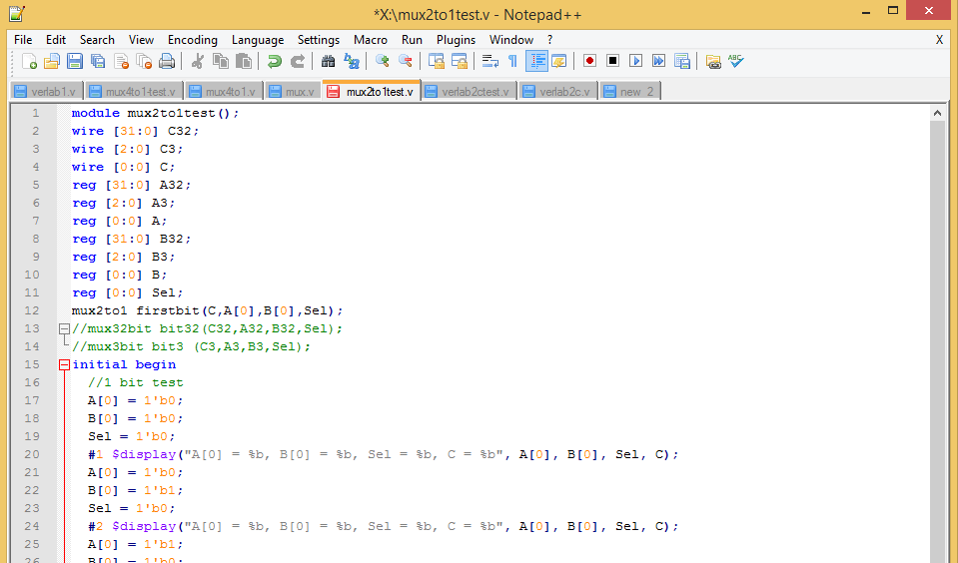
1 Bit MUX Test

Slide 6
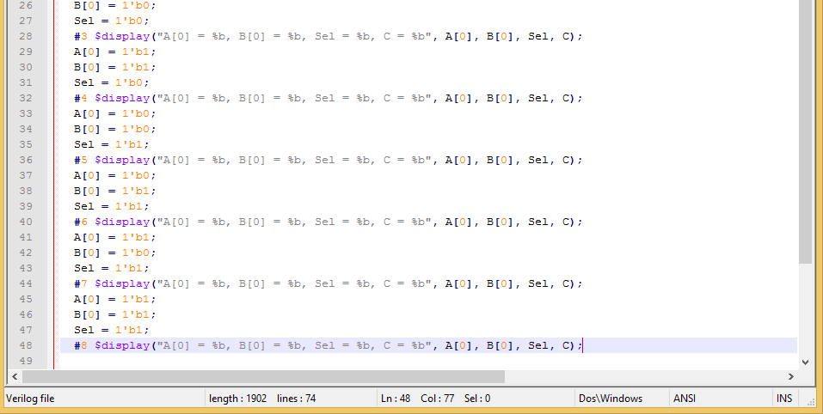
1 Bit MUX Test

Slide 7
MUX Output

Slide 8
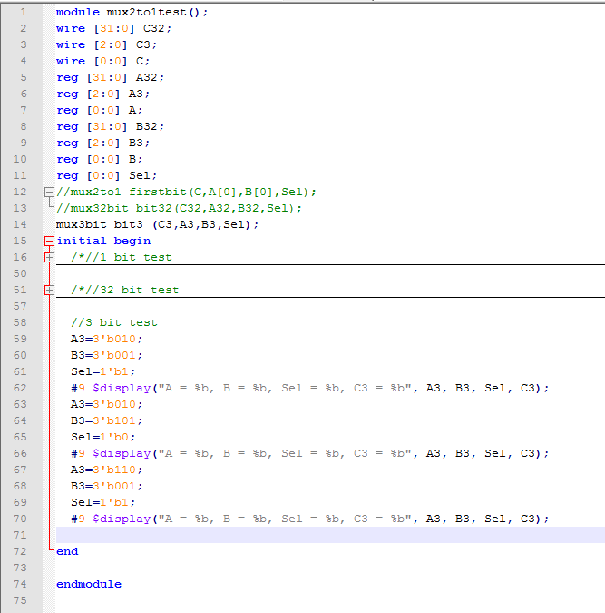
3 Bit MUX Test

Slide 9
MUX Output

Slide 10
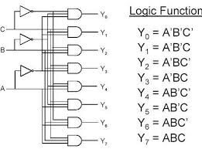
Decoder
Image from: http://www.vidyarthiplus.in/2012/01/digital-logic-circuitsencoder-and.html#.VOYas2OQUrY

Slide 11
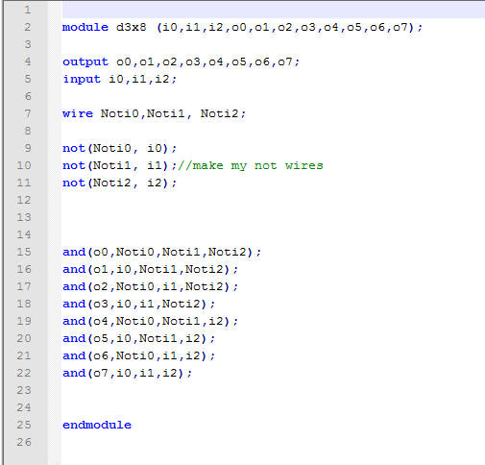
Decoder

Slide 12
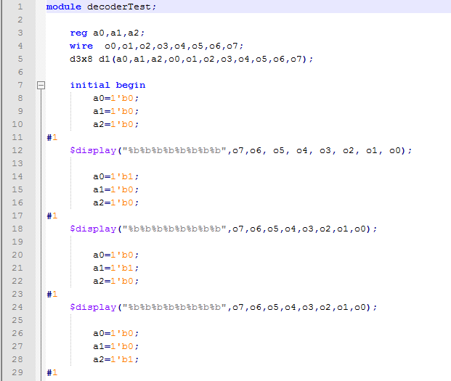
Decoder Test

Slide 13
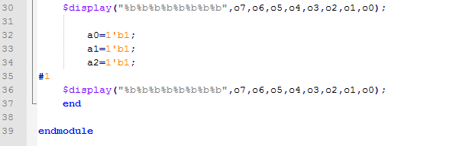
Decoder Test

Slide 14
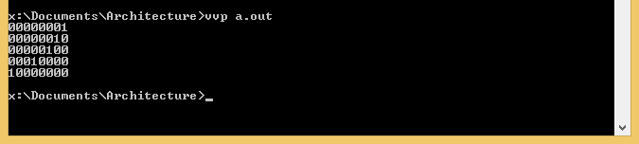
Ouput

Slide 15
ROM

Slide 16
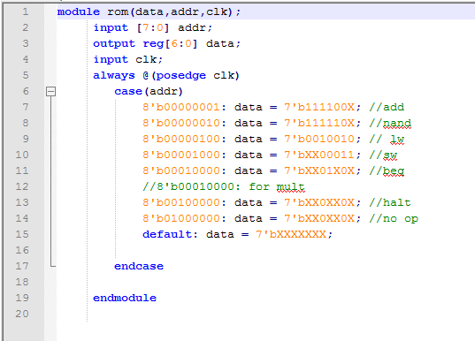
ROM.v

Slide 17
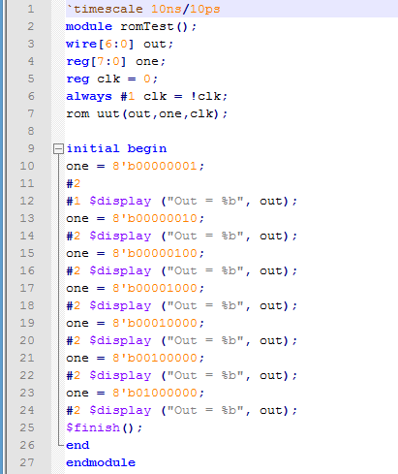
ROM Test

Slide 18
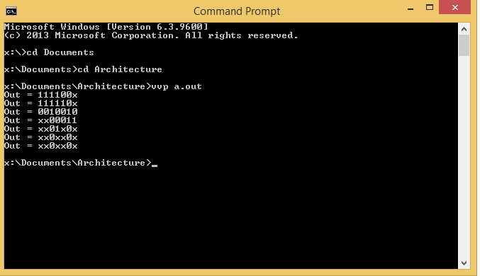
Output

